Slide 1
RDF More Explored

Slide 2
RDF provides a mechanism for recording statements about resources so that machines can easily interpret the statements.
Not only that, but RDF is based on a domain-neutral model that allows one set of statements to be merged with another set of statements, even though the information contained in each set of statements may differ dramatically.

Slide 3
three pieces of information are all that's needed in order to fully define a single bit of knowledge.
an RDF triple documents these three pieces of information in a consistent manner that ideally allows both human and machine consumption of the same data.
The RDF triple is what allows human understanding and meaning to be interpreted consistently and mechanically.

Slide 4
I (subject) have a name (property), which is Shelley Powers (property value). I (subject) have a height (property), which is five feet eleven inches (property value). I (subject) also have a location (property), which is St. Louis (property value).
each of these statements can be written as an RDF triple.

Slide 5
Each RDF triple is made up of subject, predicate, and object.
Each RDF triple is a complete and unique fact.
An (RDF) triple is a 3-tuple, which is made up of a subject, predicate and object
Each RDF triple can be joined with other RDF triples, but it still retains its own unique meaning, regardless of the complexity of the model in which it is included

Slide 6
RDF Data Model
Directed Labeled Graph
In any RDF graph, a subgraph of the graph would be a subset of the triples contained in the graph.
Taking this concept further, a union of two or more RDF graphs is a new graph, which the Model document calls a merge of the graphs.

Slide 7
Now, if the subjects differed, the merged graph would still be valid—there is no rule or regulation within the RDF graph that insists that all nodes be somehow connected with one another.
Blank nodes are never merged in a graph because there is no way of determining whether two nodes are the same—one can't assume similarity because of artificially generated identifiers.
The only components that are merged are urirefs and literals (because two literals that are syntactically the same can be assumed to be the same).
An RDF graph is considered grounded if there are no blank nodes.

Slide 8
Additionally, an instance of an RDF graph is a graph in which each blank node has been replaced by an identifier, becoming a named node.

Slide 9
Within the RDF Semantics document, entailment describes two graphs, which are equal in all aspects.
that is every assertion made about one RDF graph can be made with equal truth about the other graph.
For instance, statements made in one graph are implicitly made in the other;
if you believe the statement in the first, you must, through entailment, believe the same statement in the other.

Slide 10
entailment is not the same thing as equality.
Equality is basically two graphs that are identical, even down to the same named nodes.
Entailment implies something a little more sophisticated—that the semantics of an RDF construct as shown in a specific implementation of a graph map to that which is defined within the formal semantics of the model theoretic viewpoint of the abstract RDF graph.
The information in the entailed graph is the same as the information in the other but may have a different physical representation.

Slide 11
It is entailment that allows us to construct a graph using a node-edge-node pattern and know that this instance of the RDF graph is a valid one, and that whatever semantic constraints exist within the model theoretic viewpoint of RDF also exist within this real-world instance of RDF.
Additionally, entailment allows different manipulations of the data in the graphs, as long as the original information is preserved.

Slide 12
subgraph lemma states that a graph entails all of its subgraphs, because whatever assertions can be made about the whole graph can also be made against the subgraphs,
instance lemma, states that all instances of a graph are entailed by the graph—instance in this case an implementation of a graph in which all blank nodes have been replaced by a literal or a uriref.

Slide 13
merging lemma states that the merged graph entails all the graphs that form its final construction.
monotonicity lemma, states that if a subgraph of a graph entails another graph, then the original graph also entails that second graph.

Slide 14
The interpolation lemma states:
S entails a graph E if and only if a subgraph of the merge of S is an instance of E.
This lemma basically states that you can tell whether one set of graphs entails another if you take a subgraph of the mergence of the graphs, replace the named nodes with blank nodes, and, if the result is an instance of the second set of graphs, the first set is said to entail them

Slide 15
"To tell whether a set of RDF graphs entails another, check that there is some instance of the entailed graph which is a subset of the merge of the original set of graphs."

Slide 16
The article on giant squids, titled "Architeuthis Dux," at http://burningbird.net/articles/monsters3.htm, written by Shelley Powers, explores the giant's squid's mythological representation as the legendary Kraken as well as describing current efforts to capture images of a live specimen. In addition, the article also provides descriptions of a giant squid's physical characteristics. It is part of a four-part series, described at http://burningbird.net/articles/monsters.htm and entitled "A Tale of Two Monsters."

Slide 17
The article is uniquely identified by its URI, http://burningbird.net/articles/monsters3.htm.
The article was written by Shelley Powers—predicate is written by, value is Shelley Powers.
The article's title is "Architeuthis Dux"—predicate is title, value is Architeuthis Dux.
The article is one of a four-part series—predicate is series member, value is http://burningbird.net/articles/monsters.htm.
The series is titled "A Tale of Two Monsters"—series predicate is title, value is A Tale of Two Monsters.
The article associates the giant squid with the legendary Kraken—predicate is associates, value is Kraken and giant squid.
The article provides physical descriptions of the giant squid—predicate is provides, value is physical description of giant squid.

Slide 18
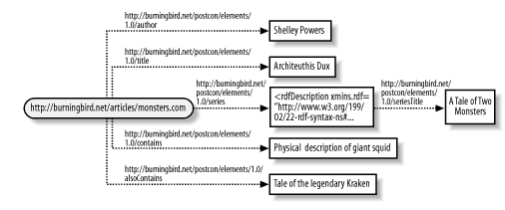
Nested Resources

Slide 19
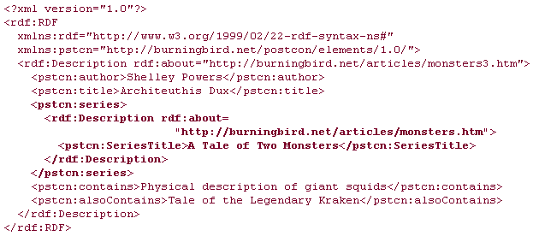
Nested Resources

Slide 20
a predicate value (object) can be either a resource or a literal.
If the object is a resource, an oval is drawn around it; otherwise, a rectangle is drawn.

Slide 21
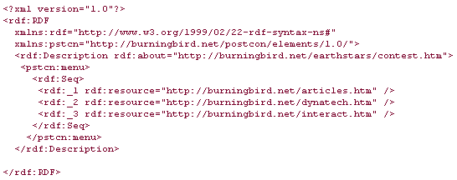
Container

Slide 22
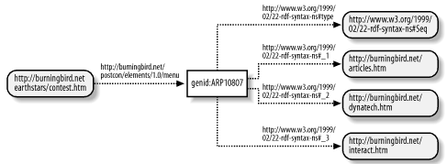
Container

Slide 23
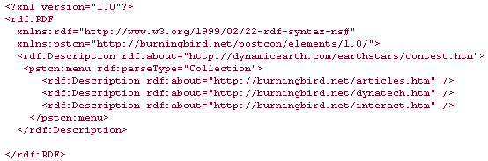
Collections
Unlike a container, a collection is considered to be a finite grouping of items, with a given terminator.

Slide 24
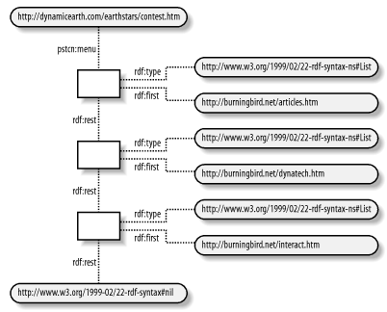
Collection
Notes:
As the graph demonstrates, a collection is a list (with rdf:type of rdf:List), and each node on the list has an associated predicate of type (List) as well as the first value in the list, given by the predicate rdf:first. Additionally, there is a relationship between the nodes, with an associated rdf:predicate of rdf:rest. The list is then terminated with a node, whose value is rdf:nil.

Slide 25
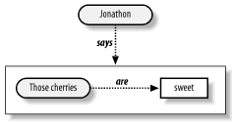
Reification
"Jonathon says those cherries are sweet"

Slide 26
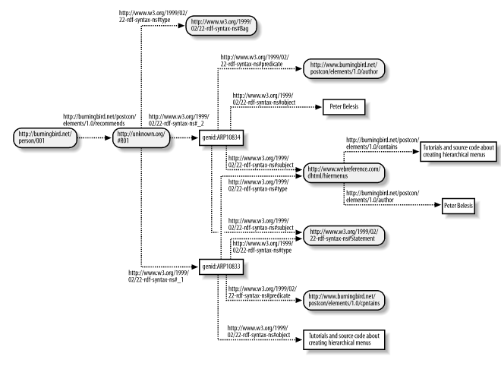
What knowledge is represented in this rdf graph?

Slide 27
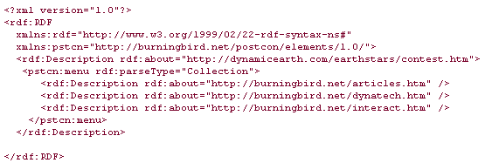
Draw a graph for the following rdf knowledge

Slide 28
RDF Schema

